Slide 1


Baruch Data Science Challenge 2021
Group 9: Tianhao Wu, Jingnan Qi, Kaiyuan Song
Notes:
https://baruch.az1.qualtrics.com/jfe/form/SV_4OaW43jNtJVXEDs

Slide 2
Business Understanding

Slide 3
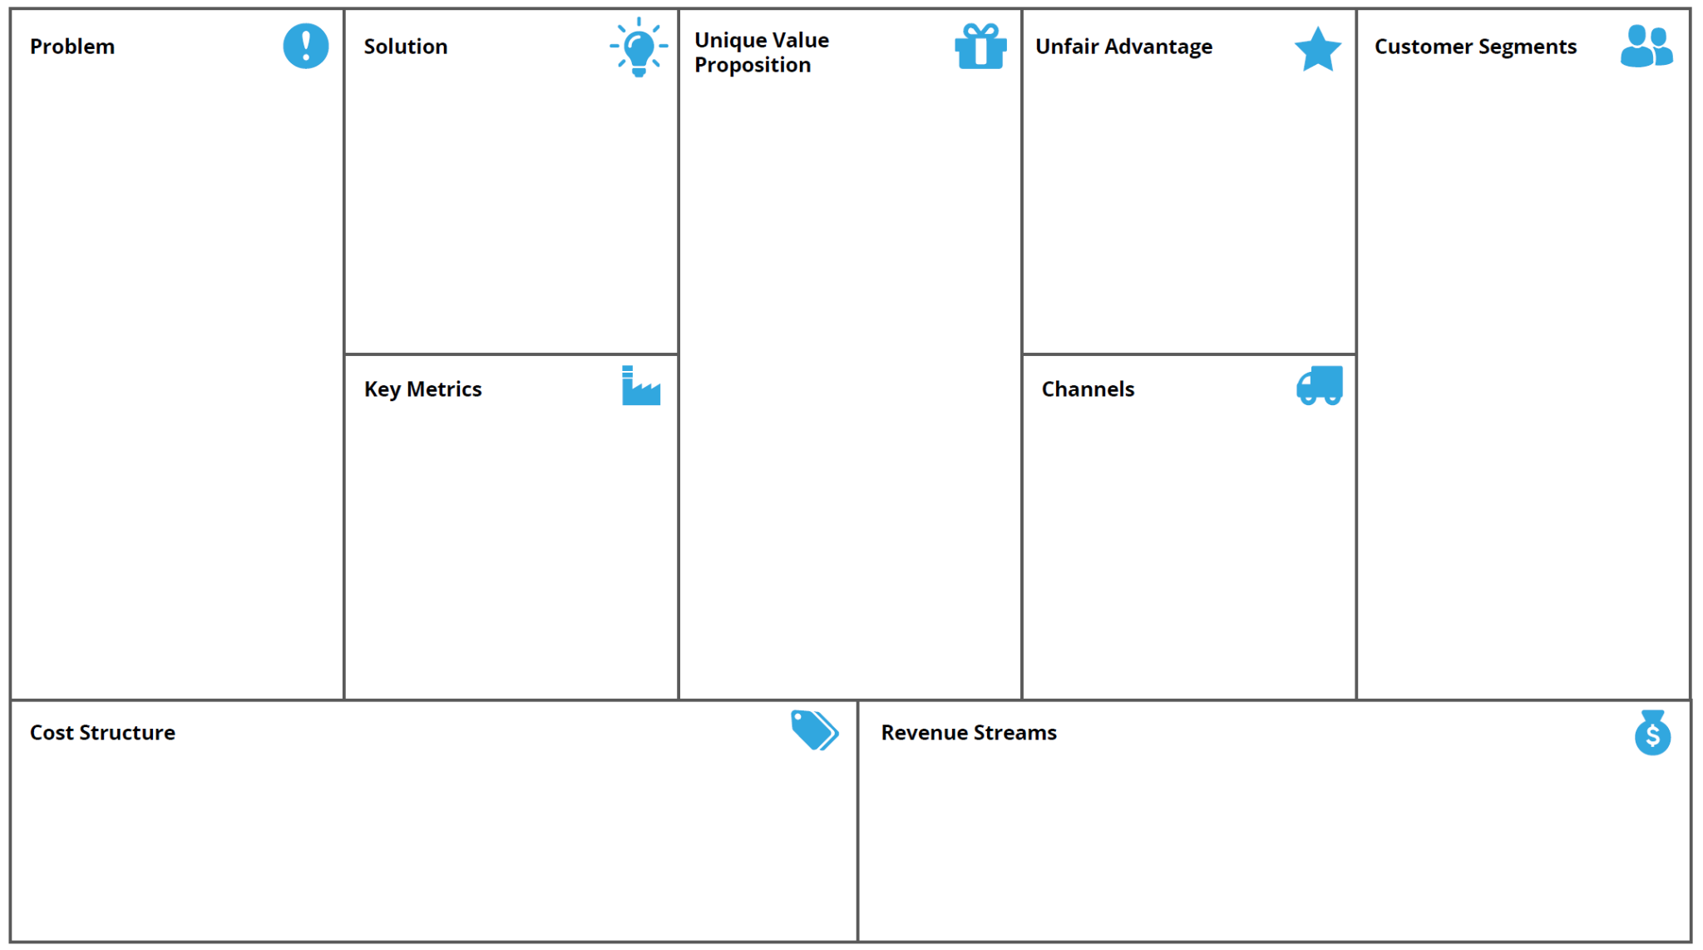
Lean Canvas
- Repair of the failing meters.
- Need fast deploy of working postage meters at customer’s site.
- Warranty and Maintenance.
Existing Alternatives:
- Contract terminates
- Buy from others
- Substitute of meter service
- Can be fixed by following online procedure or product in warranty
- Return & Upgrade
- Cloud connected meters can help us find meters which have potential problems. Can use model prediction.
- Customer who highly rely on the postage meter use at the office.
- Customer who afraid postage meter broken down in the office.
*Using the predictive pattern that model derived
- We can help prevent you from failing postage meters! By putting your meter insured, you can get free upgrade or renew of meters if your meter failed with certain years of lease.
- We have 81.6% accuracy of predicting meters that will fail in next 7 days.
- Write marketing emails or direct phone call to those customers about meters insurance.
- Broken postage meters repair cost, new device shipping cost, marketing expense and product deploy cost.
- Insuring fund provides a new cash flow to company and by using this fund to improve overall postage meter performance would generate most profit to the company.

Slide 4
Data Understanding

Slide 5
train.csv - 40500 meters
test.csv - 4500 meters
Target variable: fail_7 (1) failed (0) not failed
Total features: 54
51 numerical
1 bool
2 date
Data Quality Check
Timeliness | √ | The information is available at last record date 4/1/2021.
Completeness | ! | Missing data exists. 4 lag columns have more than 10% missing values. Need to be cleaned.
Uniqueness | √ | No duplication.
Validity | √ | Each column conforms to its format.
Consistency | √ | Data should be consistent across different systems.
Accuracy | √ | The information represents the reality of the situation.

Slide 6
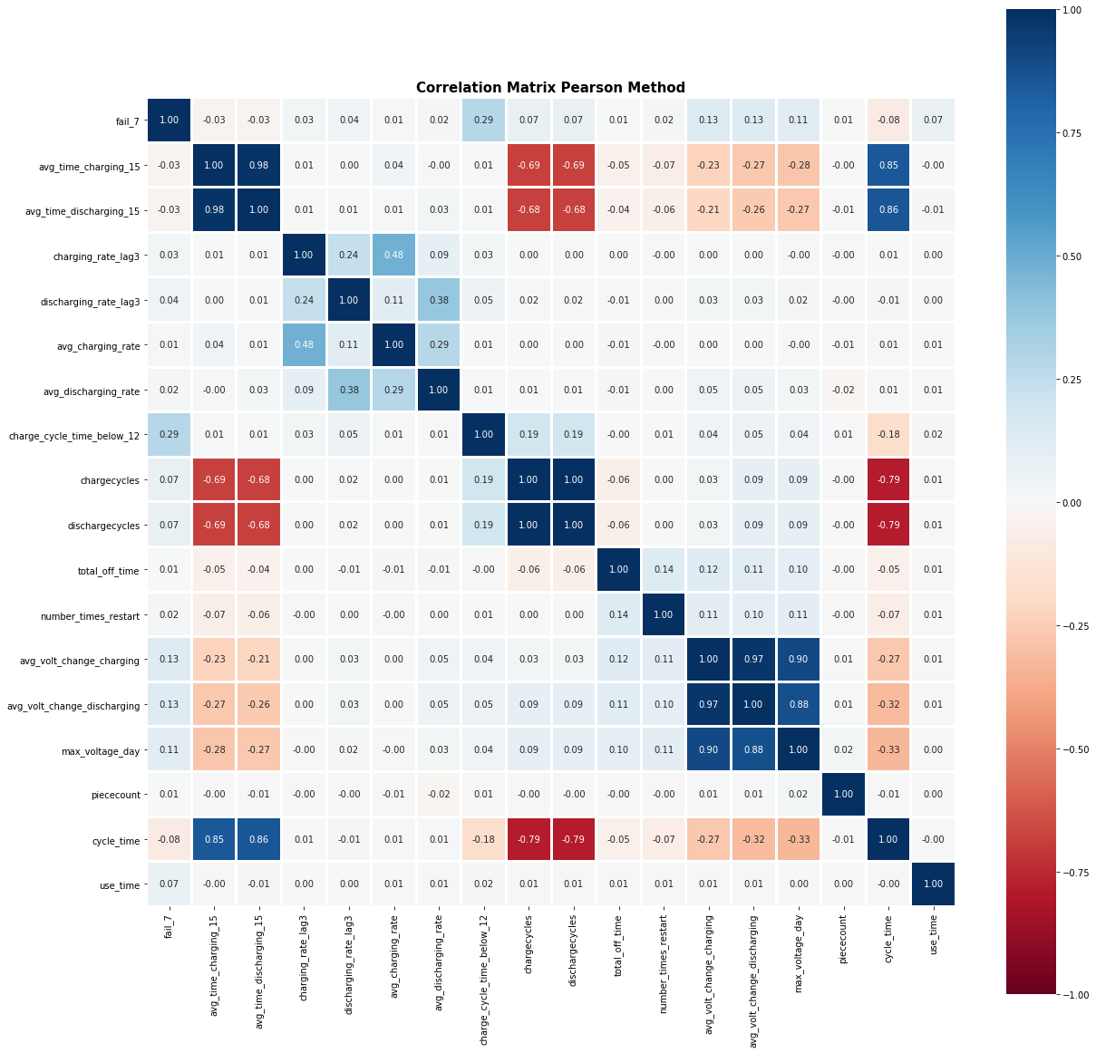
Top Features correlated with fail_7:
charge_cycle_time_below_12 | 0.29
avg_volt_change_charging | 0.13
avg_volt_change_discharging | 0.13
max_voltage_day | 0.11
chargecylces | 0.07
dischargecylces | 0.07
use_time | 0.07
cycle_time | -0.08

Slide 7
Data Preparation

Slide 8
Data Dictionary
Get rid of unwanted columns: deviceid, LastRecord (all 4/1/2021), Date Deployed
Scale Features: normalize X variables for better performance in KNN and other ML algos
Handle Missing Values: impute utilizing k-Nearest Neighbors from other X variables
Remove outliers: detect anomalies using isolation forest (2609 records/6.44%)
Derived attributes:
use_time = LastRecord- Date Deployed
avg_time_(/dis)charging_15 = average of 15 days of average (/dis)charging time
avg_(/dis)charging_rate = average of 7 days of (/dis)charging rate

Slide 9
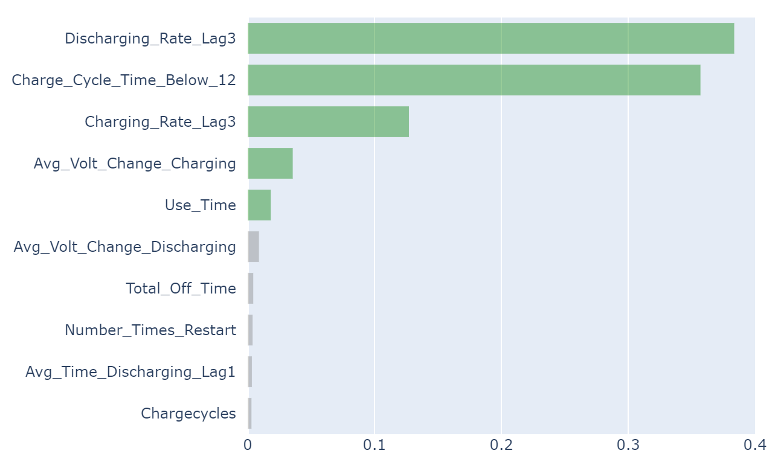
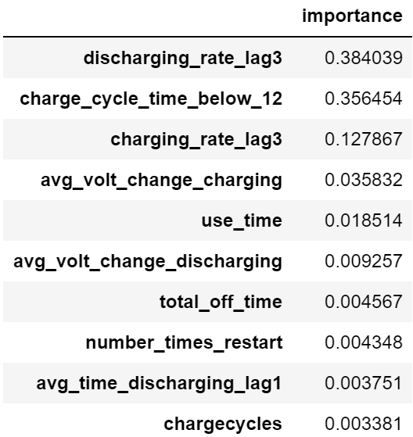
Feature Importance (from GBDT)
Top 10 Relative Feature Importance: decrease weighted impurity/increase information gain
Top 5 dominate
Why lag 3 is more important than other days? ->“Monday Effect”

Slide 10
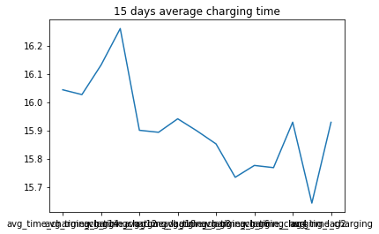
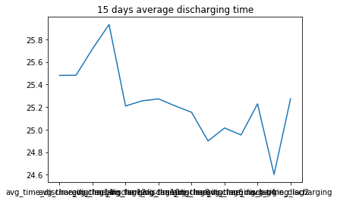
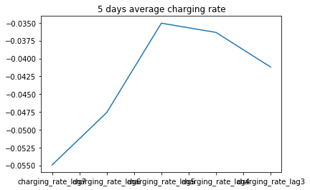
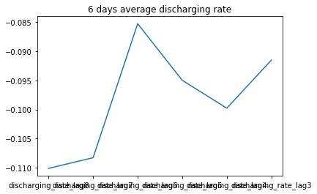

Slide 11
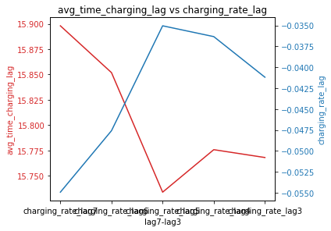
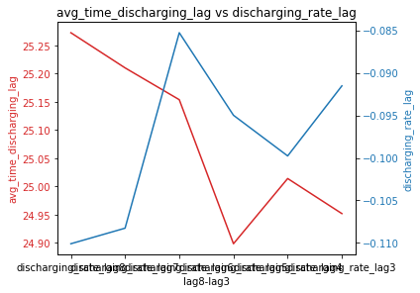
We can see that charging/discharging time and charging/discharging rate have negative relationship
Especially for lag3 (Monday), the average charging/discharging time spent is relatively lower, while the charging/discharging rate is relatively higher
Charging capacity = avg_time_charging * charging_rate
Discharging capacity = avg_time_discharging * discharging_rate

Slide 12
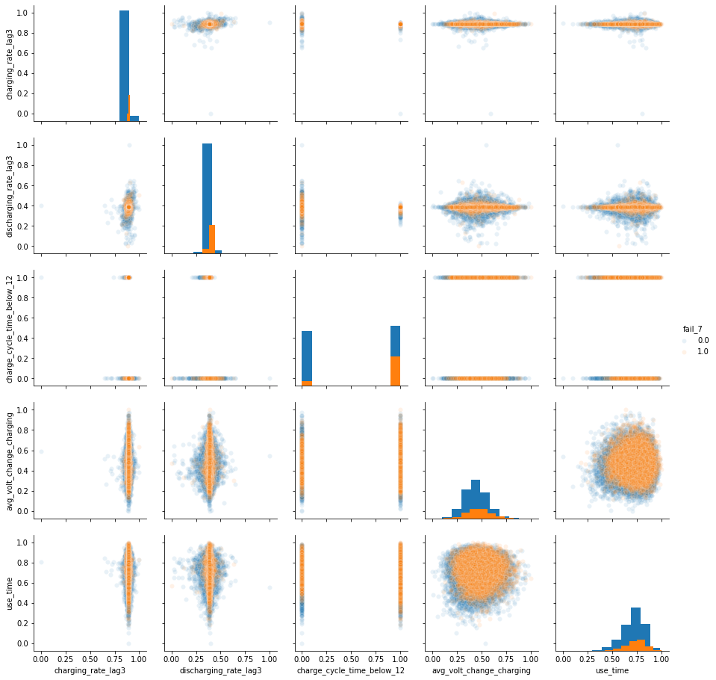
Pairplot of the 5 most important features with target variable (after scaling)
Blue: 0 (not failed)
Yellow: 1 (failed)
We can see that the top 5 important features have no explicit relationships with each other.
If charge_cycle_time_below_12 equals 1 (TRUE), the meters have higher possibility of failing.

Slide 13
Modelling

Slide 14
Feature Engineering
initial: 0.8158
Only use the 5 dominant features: 0.8165
discharging_rate_lag3
charge_cycle_time_below_12
changing_rate_lag3
avg_volt_change_changing
use_time
Add interaction & polynomial features of 5: 0.8132
Interaction terms:use_time*charge_cycle_time_below_12
Polynomial terms: avg_volt_change_chaging^2
Add average of charging rate in the past :0.8126
Create other features w/ physical meaning: <0.8158
charging_energy=avg_charging_rate*avg_charging_time
chaging_power=max_voltage_day^2
Conclusion: use original features

Slide 15
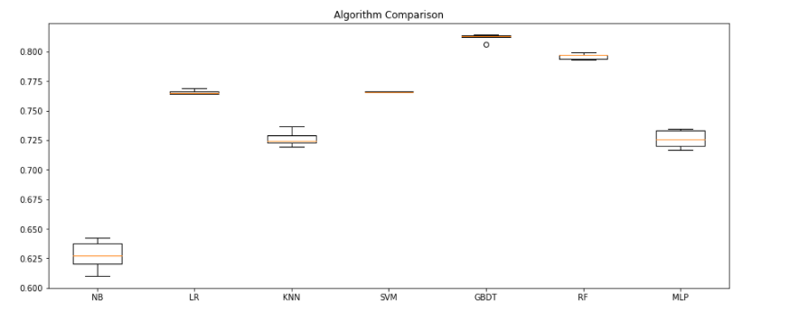
Model Selections: Gradient Boosting Decision Tree performs the best (Cross-validation accuracy)
NB: 0.627466 (0.011617)
LR: 0.765586 (0.001852)
KNN: 0.726622 (0.005926)
SVM: 0.765822 (0.000015)
GBDT: 0.811818 (0.002791)
RF: 0.795891 (0.002208)
MLP: 0.726123 (0.007150)

Slide 16
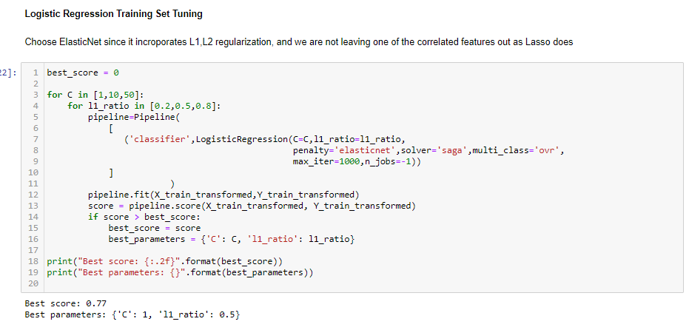
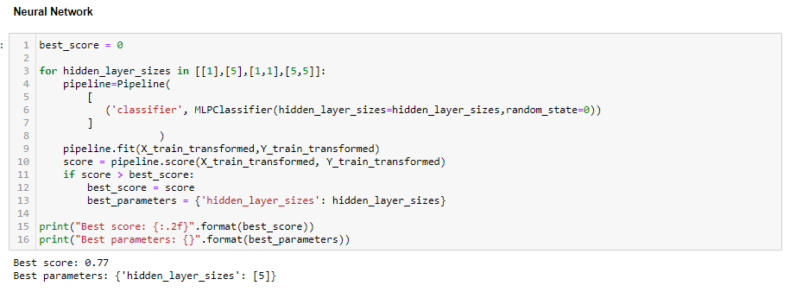
SVM takes too long to run and does not scale well in large samples datasets
Random Forest generally underperforms by GBDT in all scenarios
Even after parameter tuning, Logistic regression and Neural Network as shown above does not perform well enough
GBDT is the one to go!

Slide 17
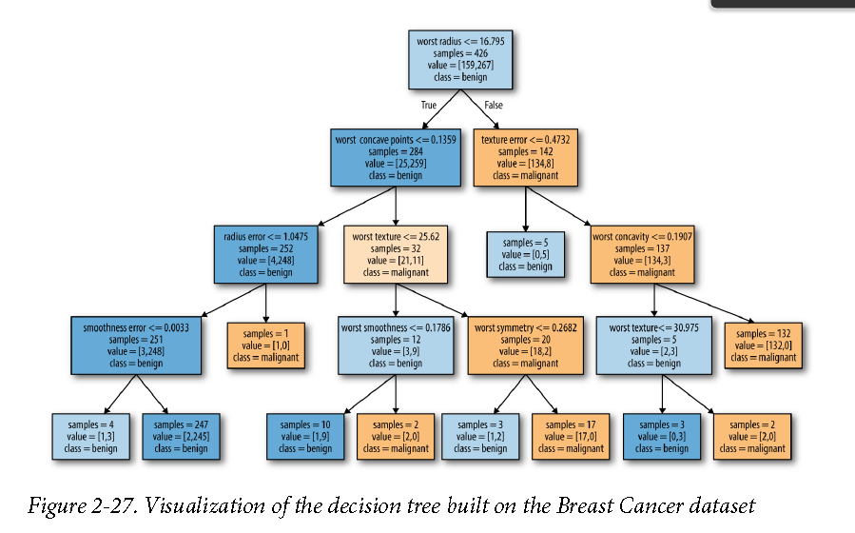
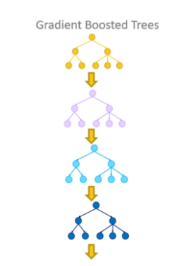
Decision Trees & GBDT
Decision Trees:
Partition data into subsets containing similar values
DT finds out the most informative splits about target variables
GBDT:
Combine multiple Decision Trees together in a serial manner
Each tree is very shallow, and corrects mistakes from previous ones

Slide 18
Evaluation

Slide 19
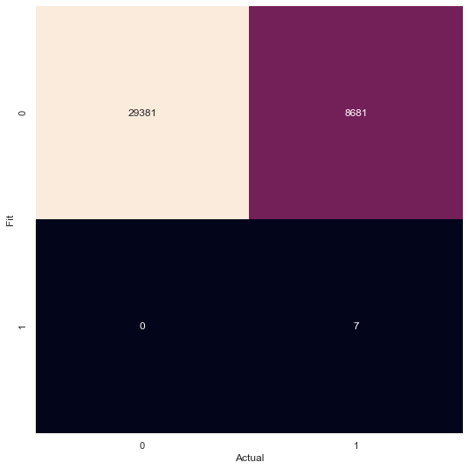
Confusion Matrix of GBM

Slide 20
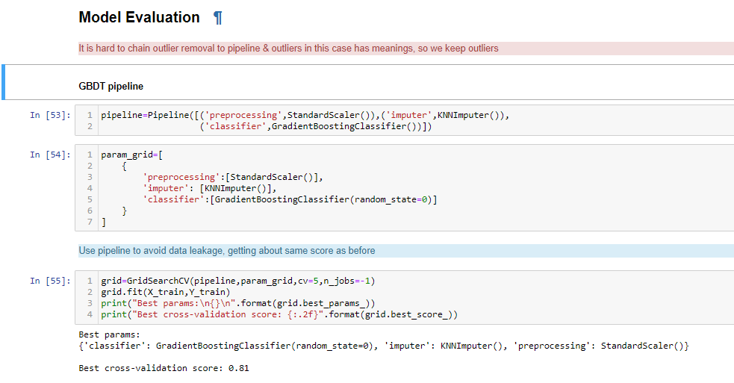
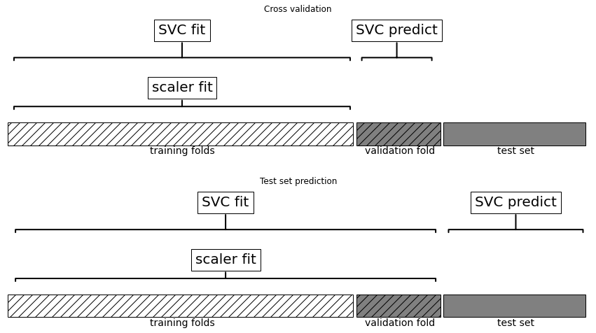
Data Leakage & Pipeline
When doing imputation before splitting folds in cross-validation, info from validation fold will leak to training folds, it will generate overly optimistic result, and affect selection of suboptimal parameters
SOLUTION: use pipeline, to do dataset splitting before any preprocessing

Slide 21
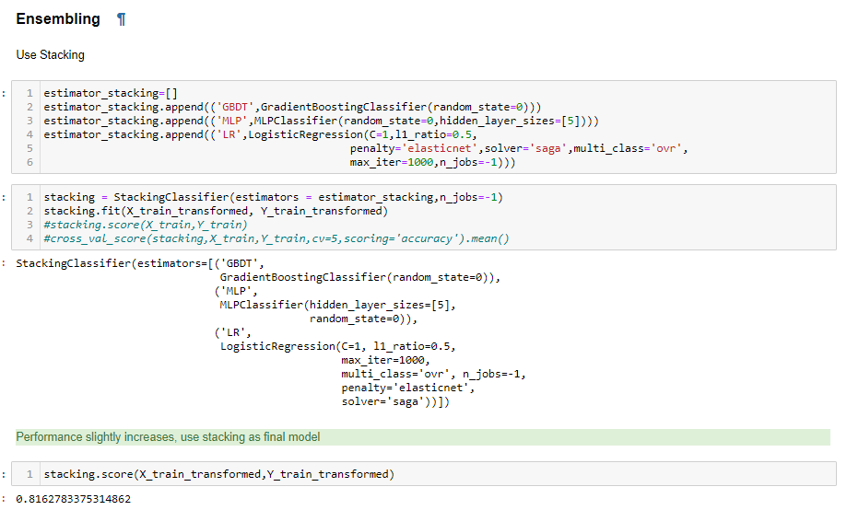
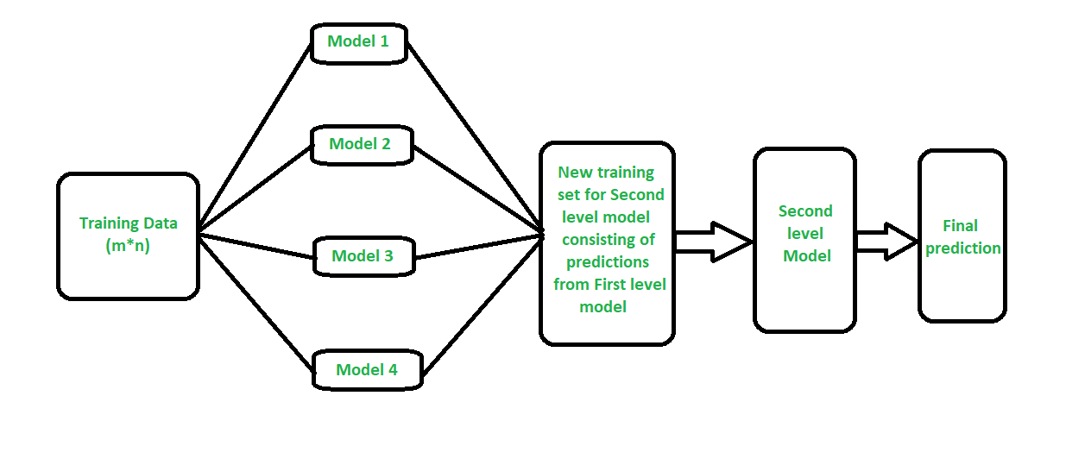
Ensembling
Stacking GBDT, Logistic Regression, and Neural Network together, to increase performance (0.816)
Stacking: use multiple model outputs as features for 2nd level model to make final prediction

Slide 22
Business Conclusions
Discharging rate 3 days ago & whether Charge cycle time<12 on the last recorded day are the most crucial features
Average voltage change in charging and total days of use are also important
By focus on monitoring these 5 core features & use GBDT to generate “dangerous” partitions to predict failure

Slide 23
Deployment

Slide 24
Design Thinking
Company side
Customer side
Postage meters can be fixed by following online procedure.
Have service team ready for all the postage meters have more than 442 days of use time.
For small postage meters, send new postage meters for customers in return of the broken (potential broken) one.
What could be done if we know these postage
meters are going to fail in next 7 days?
Analysis the data from machine and customer side and send replacement of the problem part.
For big postage meters, deploy a service team to customer’s office and do meter examination.
Determine fail conditions, send feedback to engineering team. Make product fail safe and ready to be repaired as soon as possible.

Slide 25
Thank you for watching
Notes:
https://www.pitneybowes.com/us/shipping-and-mailing/postage-meters.html
Pitney Bowes Sales Support

